Slide 1






Introduction to JavaScript
JS Syntax, JS IDE, Mix HTML and JS, JS Data Types, Variables and Scope
Intro to JavaScript
SoftUni Team
Technical Trainers
Software University
http://softuni.bg

Slide 2



Table of Contents
Compilers, Interpreters, VMs
JavaScript IDEs
JavaScript Syntax
Mixing HTML and JS
Data Types in JS
Variables and Scope
Using the JS Console

Slide 3
Have a Question?
sli.do #JSCORE

Slide 4

Static vs. Dynamic Languages
C++ / C# / Java vs. JS / PHP / Python

Slide 5
Static vs. Dynamic Languages
Static Languages
Explicit type declaration
Strongly typed
Type checking occurs at compile-time
Statically-typed languages: C, C++, C#, Java
Dynamic (Scripting) Languages
Implicit type declaration
Weakly typed
Type checking occurs at run-time
Dynamic languages: JavaScript, PHP, Python, Ruby
string name = "Pesho"
int age = 25;
let name = "Pesho"
let age = 25;

Slide 6
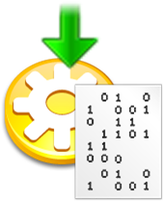
Compilers
A compiler converts a high level language code (like C#, Java) into machine code
Machine code is executed by the CPU or VM
Most errors are found at compile time, before execution
C and C++ use compilers to produce native code for the CPU
C# and Java use compilers to produce intermediate code for VM

Slide 7

Interpreters
An interpreter executes a script code line by line
Code is analyzed at run-time (no compilation)
Errors are found at run-time, during the code execution
JavaScript, Python, Ruby and PHP use interpreters
JIT (just-in time compilers) compile to native code at runtime
JIT occurs during the execution, on demand
Available for Java, JavaScript and other languages

Slide 8

Virtual Machines (VM)
Virtual machine (VM) is
A virtual computer (computer inside the computer)
Runs an intermediate code for a virtual CPU
VM-based languages:
JVM (Java Virtual Machine) for Java
CLR (Common language Runtime) for C# / .NET
HHVM for PHP

Slide 9

Compiler vs. Interpreter vs. Virtual Machine
Compiled languages are faster than interpreted languages
C, C++, Go and Swift are very fast
Compiled to native code for CPU
C# and Java are slower
Compiled to intermediate code for VM
JS, Python, Ruby, PHP are even slower
Interpreted / JIT-compiled

Slide 10



JavaScript IDEs
Development Environments for JS

Slide 11
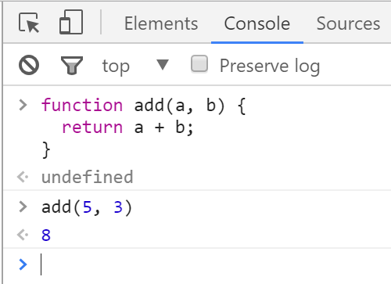

Chrome Web Browser
Developer Console: [F12]

Slide 12
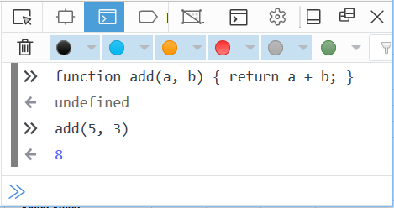

Firefox Web Browser
Developer Console: [Ctrl] + [Shift] + [i]

Slide 13
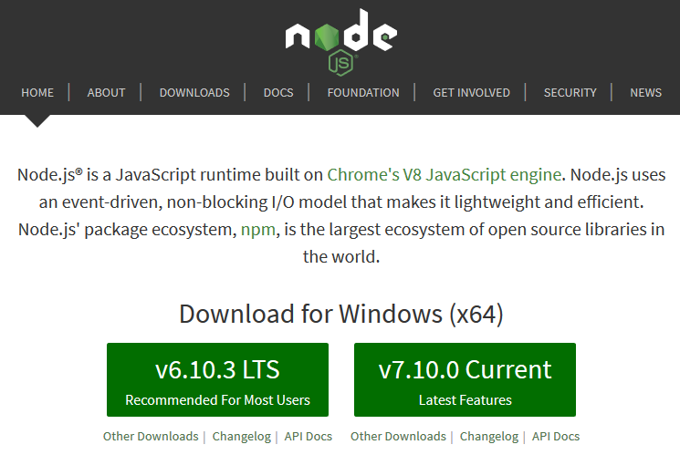
Install the Latest Node.js

Slide 14
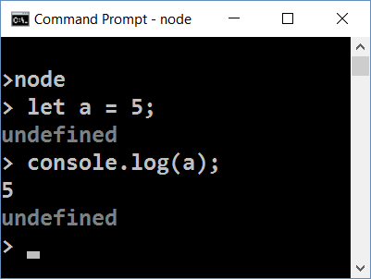
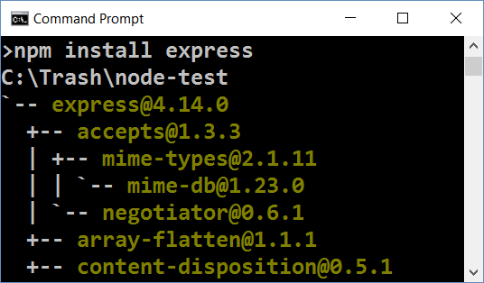
Node.js
What is Node.js?
Server-side JavaScript runtime
Chrome V8 JavaScript engine
npm package manager
Install node packages

Slide 15
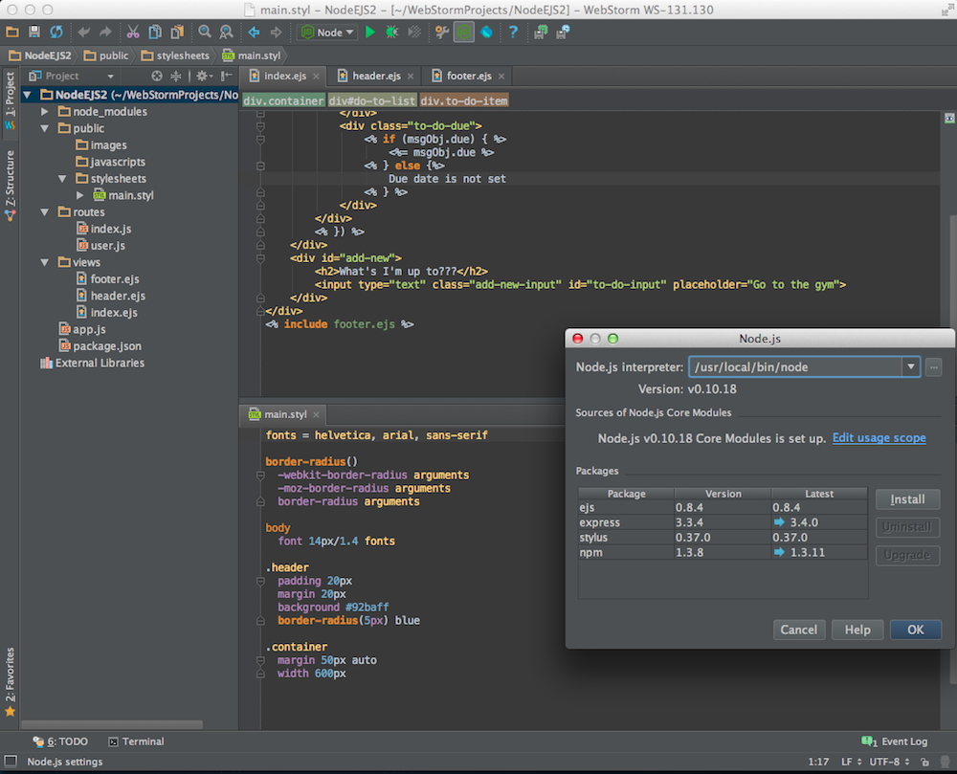
Install WebStorm
Very Smart JavaScript IDE

Slide 16

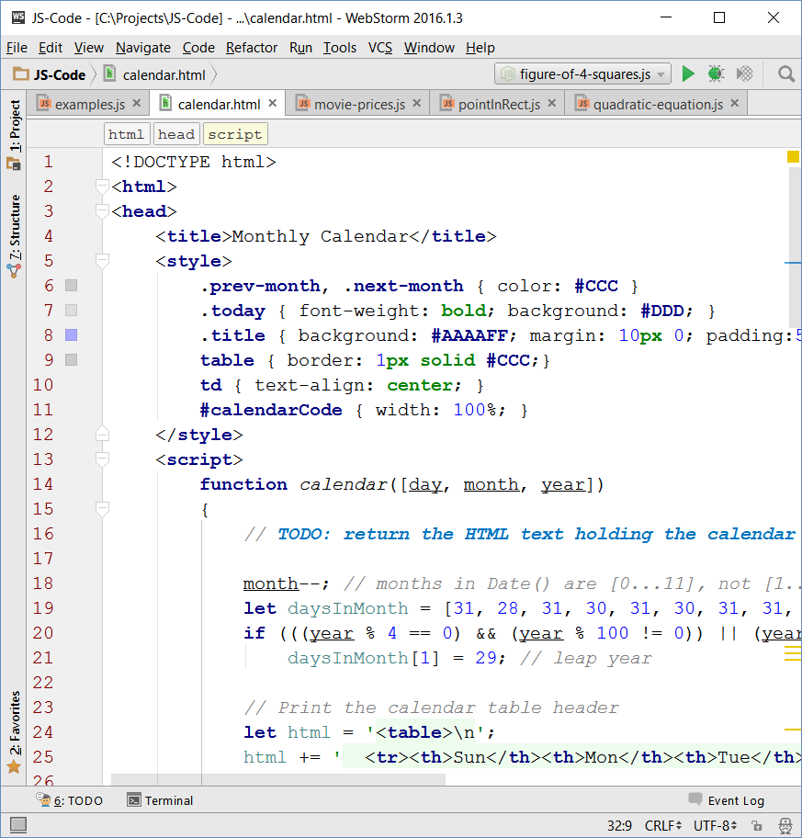
WebStorm
Powerful IDE for HTML5
JavaScript, HTML, CSS
Babel, TypeScript, Sass / LESS, …
Code, run, debug JS code
Paid product
Free license for SoftUni students

Slide 17
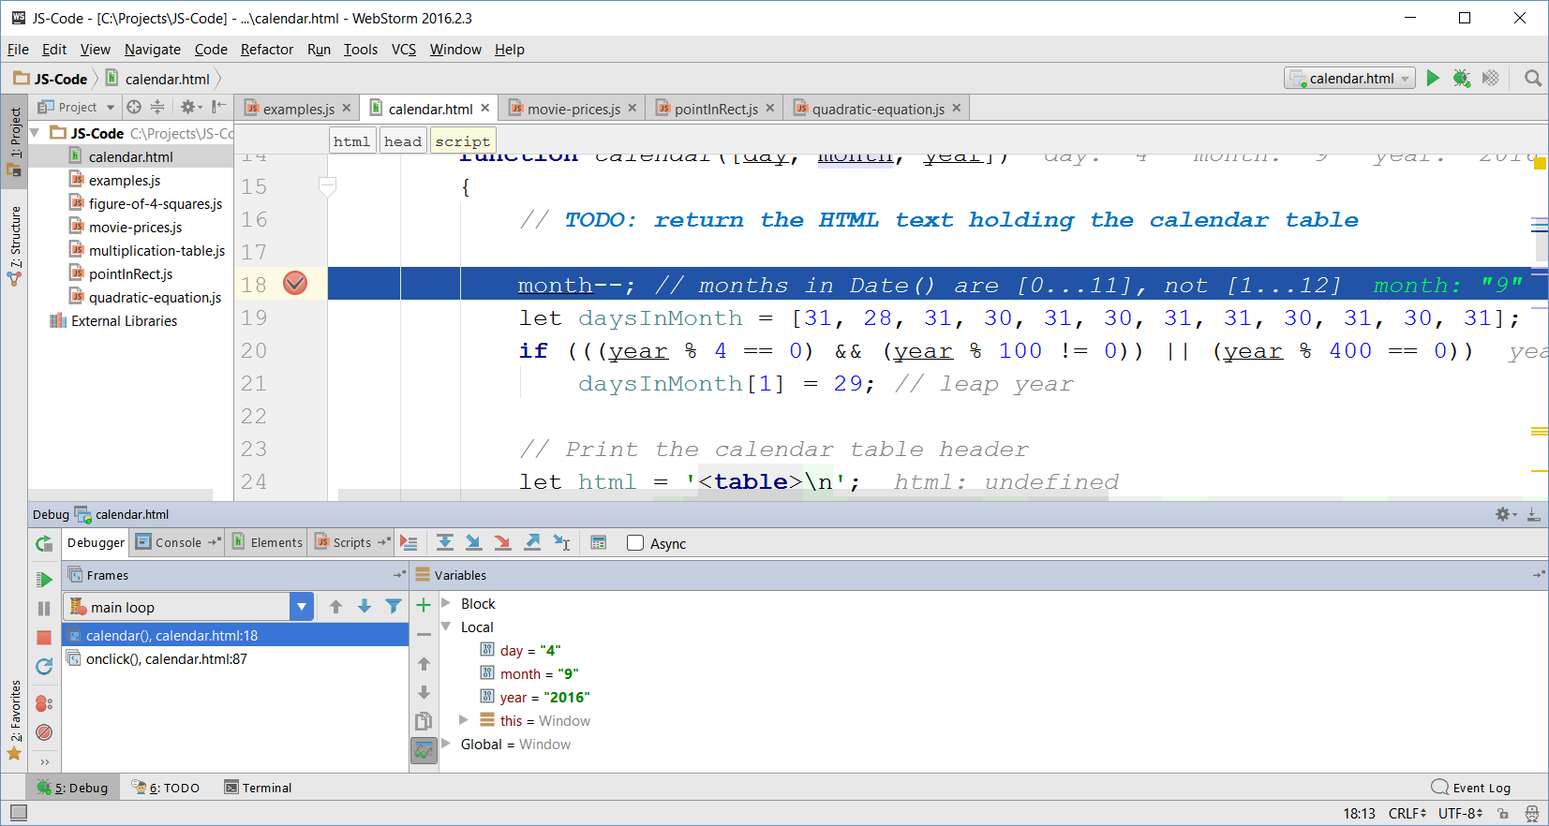
WebStorm Debugger

Slide 18


Visual Studio + Node.js Tools
Optionally, install Visual Studio 2015 Community (free)
Optionally, install Node.js Tools for Visual Studio

Slide 19
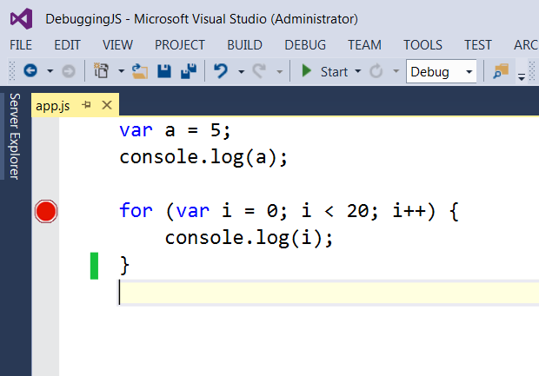
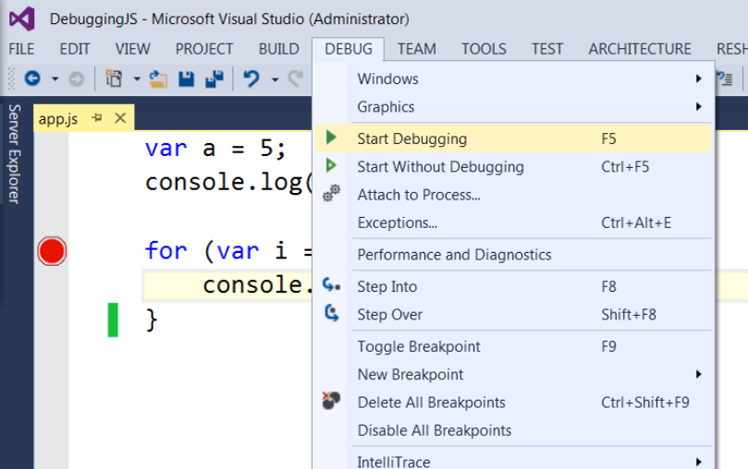
Debugging Node.js in Visual Studio
Just like the C# debugger
Toggle a breakpoint and start debugging with [F5]

Slide 20
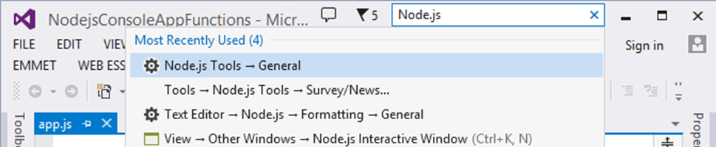
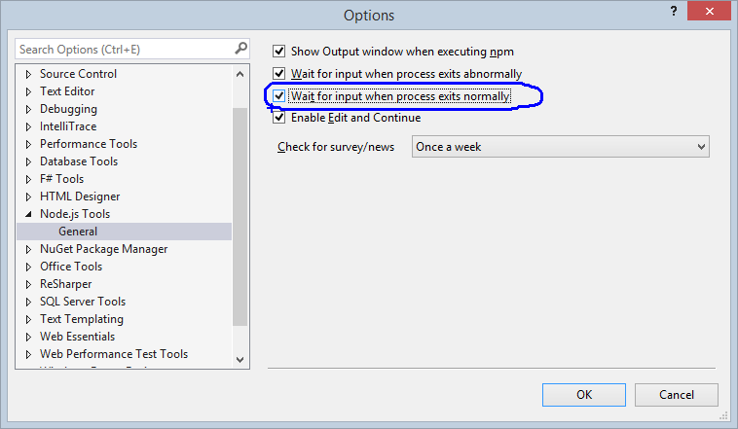
VS + Node.js Tools: Lost Console Output
Problem: the console is lost just after my JS program finishes
I can't see the program output
How to keep it?

Slide 21

JavaScript Syntax

Slide 22
JavaScript Syntax
The JavaScript syntax is similar to C#, Java and PHP
Operators (+, *, =, !=, &&, ++, …)
Variables (typeless)
Conditional statements (if, else)
Loops (for, while)
Functions (with parameters and return value)
Arrays (arr[5]) and associative arrays (arr['maria'])
Objects and classes

Slide 23
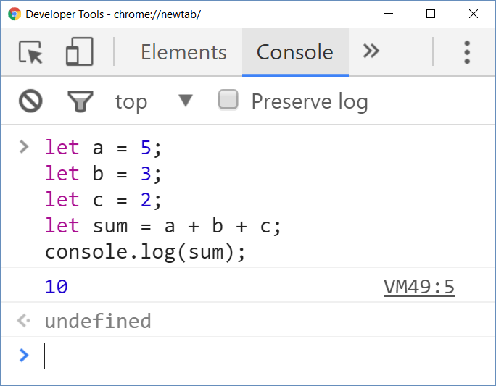
JavaScript Code – Example
JS variables, operators, expressions, statements
let a = 5;
let b = 3;
let c = 2;
let sum = a + b + c;
console.log(sum);

Slide 24
Problem: Function to Sum 3 Numbers
Use camelCase for function names
The { stays on the same line
function sumNumbers(a, b, c) {
let sum = a + b + c;
console.log(sum);
}
The input comes as number arguments
Print the sum at the console
Check your solution here: https://judge.softuni.bg/Contests/287

Slide 25
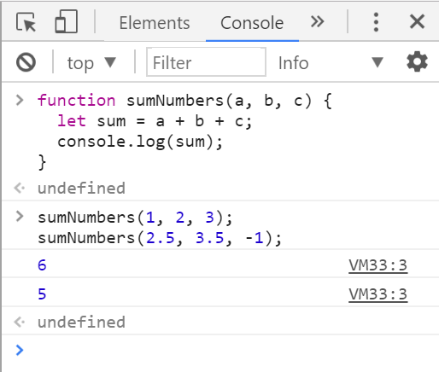
Test the Function in Your Browser
Call the function with three arguments holding numbers:
sumNumbers(1, 2, 3);
// 6
sumNumbers(2.5, 3.5, -1);
// 5
sumNumbers(-1, -2, -3);
// -6

Slide 26
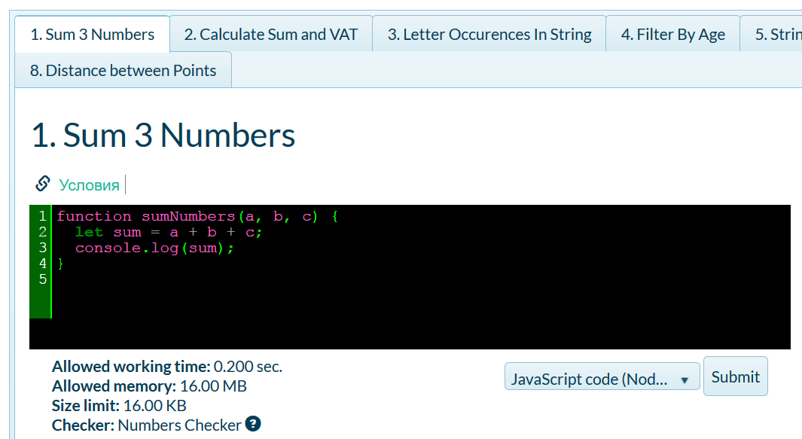
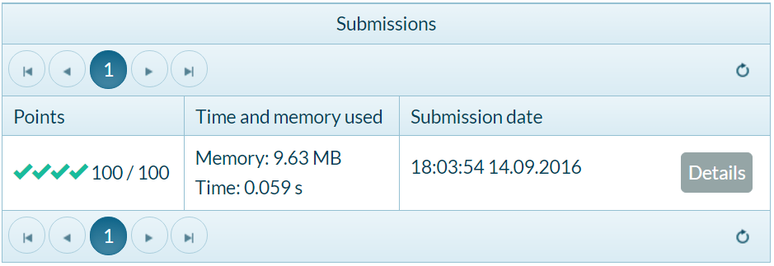
Test the Function in the Judge System

Slide 27



Mix HTML and JavaScript
Using JS Code from HTML Page

Slide 28
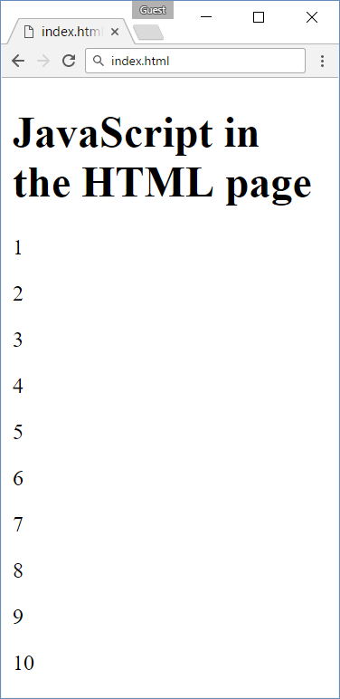
Mixing HTML + JavaScript
<!DOCTYPE html>
<html>
<body>
<h1>JavaScript in the HTML page</h1>
<script>
for (let i=1; i<=10; i++) {
document.write(`<p>${i}</p>`);
}
</script>
</body>
</html>

Slide 29
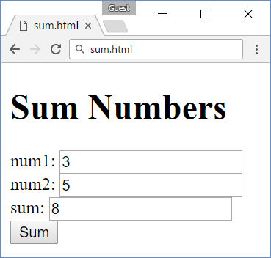
Sum Numbers with HTML Form
<form>
num1: <input type="text" name="num1" /> <br>
num2: <input type="text" name="num2" /> <br>
sum: <input type="text" name="sum" /> <br>
<input type="button" value="Sum" onclick="calcSum()" />
</form>
function calcSum() {
let num1 = document.getElementsByName('num1')[0].value;
let num2 = document.getElementsByName('num2')[0].value;
let sum = Number(num1) + Number(num2);
document.getElementsByName('sum')[0].value = sum;
}

Slide 30
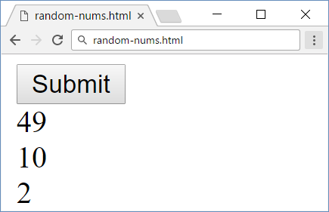
Load JavaScript File from HTML Document
random-nums.html
numbers.js
<!DOCTYPE html>
<html>
<head>
<script src="numbers.js">
</script>
</head>
<body>
<input type="submit"
onclick="printRandNum()" />
</body>
</html>
function printRandNum() {
let num = Math.round(
Math.random() * 100);
document.body.innerHTML +=
`<div>${num}</div>`;
}

Slide 31

Data Types in JS
Numbers, Strings, Booleans, Objects

Slide 32
Numbers in JavaScript
All numbers in JS are floating-point (64-bit double-precision)
let n = 5;
console.log(typeof(n) + ' ' + n); // number 5
let bin = 0b10000001;
console.log(typeof(bin) + ' ' + bin); // number 129
let x = Number.parseInt("2.99");
console.log(typeof(x) + ' ' + x); // number 2
let y = Number("2.99");
console.log(typeof(y) + ' ' + y); // number 2.99

Slide 33
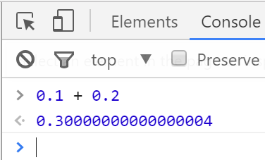
Numbers in JavaScript are Floating-Point
let a = 3, b = 4 / a;
console.log(`a=${a} b=${b}`); // a=3 b=1.3333333333333333
console.log(a / 0); // Infinity
console.log(a * Infinity); // Infinity
console.log(0 / 0); // NaN
let bigNum = 10000000000000000;
console.log(bigNum + 1); // 10000000000000000
let num = 0.01, sum = 0;
for (let i=0; i<100; i++)
sum += num;
console.log(sum); // 1.0000000000000007

Slide 34
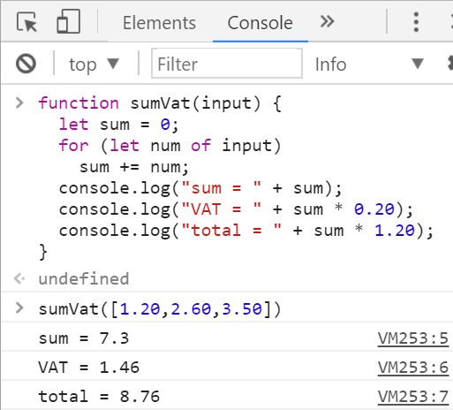
Problem: Calculate Sum + VAT
You are given an array of numbers
Print their sum, 20% VAT and total sum
function sumVat(input) {
let sum = 0;
for (let num of input)
sum += num;
console.log("sum = " + sum);
console.log("VAT = " + sum * 0.20);
console.log("total = " + sum * 1.20);
}
sumVat([1.20,2.60,3.50])
Check your solution here: https://judge.softuni.bg/Contests/287

Slide 35
Strings in JavaScript
Strings in JS are immutable sequences of Unicode characters
let ch = 'x';
console.log(typeof(ch) + ' ' + ch); // string x
let str = "hello";
console.log(typeof(str) + ' ' + str); // string hello
console.log(str.length); // 5
console.log(str[0]); // h
str[0] = 's'; // Beware: no error, but str stays unchanged!
console.log(str); // hello
console.log(str[10]); // undefined
In strict mode this gives error

Slide 36
Problem: Letter Occurrences in String
We are given a string (text) and a letter
Count how many times given letter occurs in given string
function countLetter(str, letter) {
let count = 0;
for (let i=0; i<str.length; i++)
if (str[i] == letter)
count++;
return count;
}
The input comes as two strings: str and letter
countLetter('hello', 'l')
Check your solution here: https://judge.softuni.bg/Contests/287

Slide 37
Objects in JavaScript
JS objects hold key-value pairs
let point = {x: 5, y: -2};
console.log(point); // Object {x: 5, y: -2}
console.log(typeof(point)); // object
let rect = {name:"my room", width: 4.5, height: 3.5};
rect.name = "old room";
rect.color = "red";
console.log(rect); // Object {name: "old room", width: 4.5, height: 3.5, color: "red"}
rect = undefined; // "rect" now has no value
console.log(rect); // undefined

Slide 38
Problem: Filter By Age
We are given a minimum age and two pairs of names and ages
Store each name and age into an object
Print each object whose age ≥ minimum age
function filterByAge(minAge, nameA, ageA, nameB, ageB) {
let personA = {name:nameA, age:ageA};
let personB = {name:nameB, age:ageB};
if (personA.age >= minAge) console.log(personA);
if (personB.age >= minAge) console.log(personB);
}
filterByAge(12, 'Ivan', 15, 'Asen', 9)
Check your solution here: https://judge.softuni.bg/Contests/287

Slide 39
Automatic Type Conversion
JS converts between types automatically
let ch = 'x'; // string
console.log(typeof(ch));
ch++; // ch is now number
console.log(typeof(ch));
console.log(ch); // NaN
let num = 0xFF; // 255
console.log(typeof(num));
num = num + "x"; // string
console.log(typeof(num));
console.log(num); // 255x
let n = "1" * 1; // number
let b = Boolean(n);
console.log(typeof(b));
console.log(b); // true
let n = [1]; // array
console.log(typeof(n));
n++; // n is now 2 (number)
console.log(typeof(n));

Slide 40
Problem: String of Numbers 1…N
Write a JS function that concatenates numbers as text
Input: a string parameter, holding a number n
Output: the numbers 1…n, concatenated as single string
Example: '11' → "1234567891011"
function numbers(n) {
let str = '';
for (let i=1; i<=n; i++) str += i;
return str;
}
numbers('11')
Check your solution here: https://judge.softuni.bg/Contests/287

Slide 41


Variables and Scope
let x = 5;
let vs. var

Slide 42
Assigning Variables
Variables in JS have no type, values have type
let x = 5; console.log(typeof(x)); // x is number
x = 'str'; console.log(typeof(x)); // x is now string
x = {x:5, y:7}; console.log(typeof(x)); // x is now object
let n = 5, str = "hello"; // Assigning variables
// Group declaration + assignment (destructuring)
let [name, x, y] = ["point", 5, 7];
console.log(`${name}(${x}, ${y})`); // point(5, 7)

Slide 43
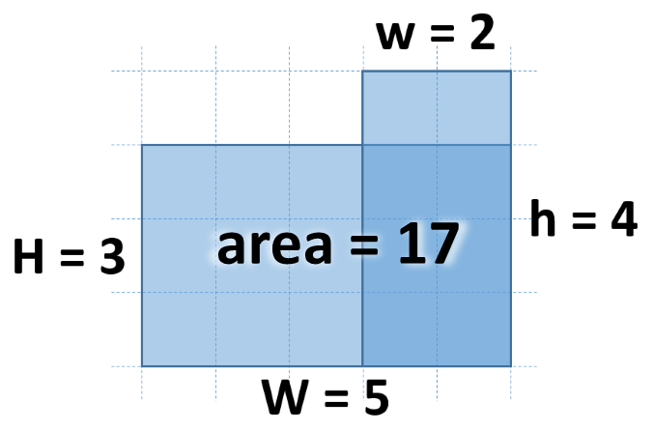
Problem: Figure Area
Calculate the figure area by given w, h, W and H
Sample solution:
2
4
5
3
17
function figureArea(w, h, W, H) {
let [s1, s2, s3] = [w * h, W * H,
Math.min(w, W) * Math.min(h, H)];
return s1 + s2 - s3;
}
figureArea(2, 4, 5, 3)
Check your solution here: https://judge.softuni.bg/Contests/287

Slide 44
Undefined Variables
JS cannot access undefined variables
Once defined, variables cannot be deleted!
console.log(x);
// Uncaught ReferenceError: x is not defined(…)
let x = 5;
x = undefined;
console.log(x); // undefined
// The variable x exists, but has no value defined

Slide 45
Variable Scope: let vs. var
let has "block scope"
var has "function scope"
for (let x=1; x<=5; x++)
console.log(x); // 1 … 5
console.log(x); // Ref. error
for (var x=1; x<=5; x++)
console.log(x); // 1 … 5
console.log(x); // 6
function test() {
console.log(x); // Ref. error
let x = 5;
}
test();
function test() {
console.log(x); // undefined
var x = 5;
}
test();

Slide 46
Variable Scope: let vs. var (2)
let has "block scope"
var has "function scope"
let x = 100; // block scope
console.log(x); // 100
for (let x=1; x<=5; x++) {
console.log(x); // 1 … 5
} // end of block scope
console.log(x); // 100
var x = 100; // function scope
console.log(x); // 100
for (var x=1; x<=5; x++) {
console.log(x); // 1 … 5
} // same x inside the loop
console.log(x); // 6
console.log(x); // Ref. error
let x;
console.log(x); // undefined
var x;

Slide 47
Global Variables
In the Web browser
Server side (in Node.js)
x = 5;
console.log(x); // 5
console.log(window.x); // 5
x = 5;
console.log(x); // 5
console.log(global.x); // 5
Strict mode forbids using global variables
'use strict';
x = 10; // Reference error
window.x = 5;
console.log(x);
'use strict';
window.x = 5;
x = 10; // This will work
console.log(x); // 10

Slide 48
Constant Declarations
JS supports constants – declared by the const keyword
Once assigned, constants cannot be modified
const path = '/images';
console.log(`${path}/logo.png`);
// Logo path: /images/logo.png
path = '/img/new';
// TypeError: Assignment to constant variable

Slide 49


Using the JS Console
The "console" Object

Slide 50
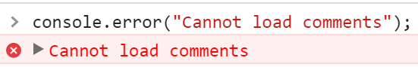
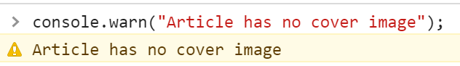
The "console" Object in JS
Always appends a trailing new line: \n
console.log("The date is: " + new Date());
console.error("Cannot load comments");
console.warn("Article has no cover image");

Slide 51
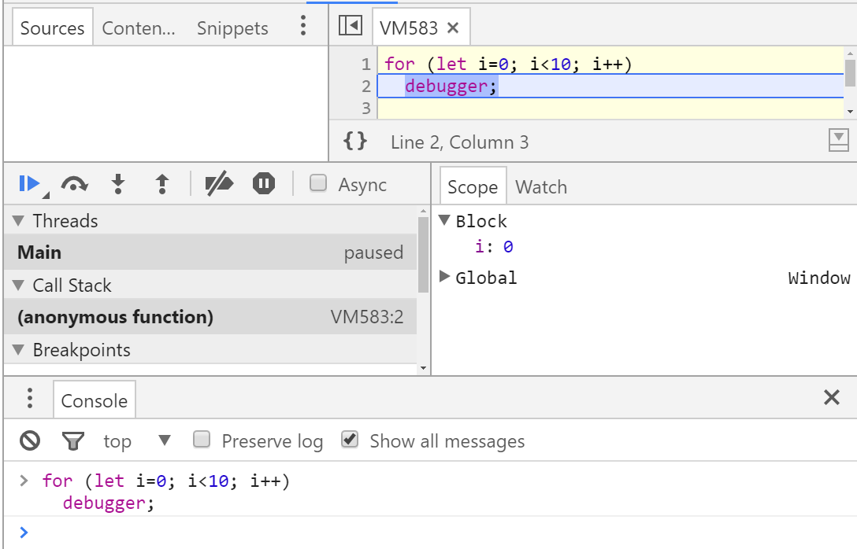
Invoking the JS Debugger
for (let i=0; i<10; i++)
debugger;

Slide 52
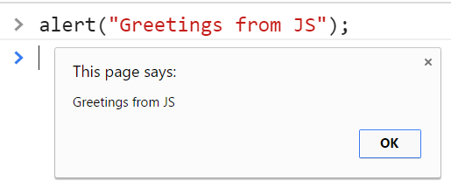
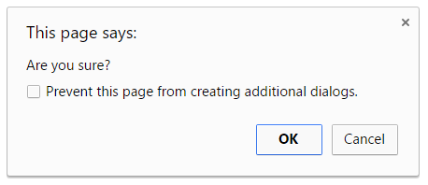
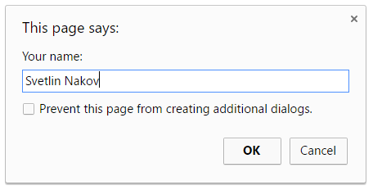
Alert / Confirm / Prompt Popups
In the browser we have alert(), confirm() and prompt()
alert("Greetings from JS");
if (confirm("Are you sure?")
document.write("Confirmed");
else
document.write("Canceled");
let name = prompt("Your name:");
alert(`Hello, ${name}`);

Slide 53
Problem: Next Day
Print the next day by given year, month, day
Example: 2016, 9, 30 → 2016-10-1
function calcNextDay(year, month, day) {
let date = new Date(year, month-1, day);
let oneDay = 24 * 60 * 60 * 1000; // milliseconds in 1 day
let nextDate = new Date(date.getTime() + oneDay);
return nextDate.getFullYear() + "-" +
(nextDate.getMonth() + 1) + '-' +
nextDate.getDate();
}
calcNextDay(2016, 9, 30)
Check your solution here: https://judge.softuni.bg/Contests/287

Slide 54
Problem: Distance Between Points
2
4
5
0
Return the distance between two points
Sample solution:
5
function distanceBetweenPoints(x1, y1, x2, y2) {
let pointA = {x:x1, y:y1};
let pointB = {x:x2, y:y2};
let distanceX = Math.pow(pointA.x - pointB.x, 2);
let distanceY = Math.pow(pointA.y - pointB.y, 2);
return Math.sqrt(distanceX + distanceY);
}
Use the Pythagorean theorem
distanceBetweenPoints(2, 4, 5, 0)
Check your solution here: https://judge.softuni.bg/Contests/287

Slide 55

Practice: Data Types and Variables
let x = 5;
Live Exercises in Class (Lab)

Slide 56

Summary
JavaScript – dynamic (scripting) language
Variables have no type, values have type
Node.js – server-side JS engine
WebStorm – powerful, modern JS IDE
Insert JS in HTML by <script src=…></script>
Numbers in JS are always floating-point (no integers)
JS uses automatic type conversion: "3" * true → 3
var gives "function scope", let gives "block scope"

Slide 57







Introduction to JavaScript
https://softuni.bg/courses/

Slide 58
License
This course (slides, examples, demos, videos, homework, etc.) is licensed under the "Creative Commons Attribution-NonCommercial-ShareAlike 4.0 International" license

Slide 59





Free Trainings @ Software University
Software University Foundation – softuni.org
Software University – High-Quality Education, Profession and Job for Software Developers
softuni.bg
Software University @ Facebook
facebook.com/SoftwareUniversity
Software University Forums
forum.softuni.bg

